Slide 1


Slide A
Navigation
At the end of the last class, we started considering energy transfer in the cart, track, and box system in order to better understand what is happening in that system.
Discuss as a Class
What new questions did thinking about energy transfer into and through the entire system raise for you?
Notes:
Share questions that were raised at the end of the last lesson. Say, At the end of the last class, we started considering energy transfer in the launcher, cart, track, and box system in order to better understand what is happening in that system. What new questions did thinking about energy transfer in the entire system raise for you? Display slide A. Discuss these questions as a class. Example prompts and responses are located in the teacher guide.
Say, In order to think about the energy transfer into and through an entire system, scientists and engineers often break bigger systems into subsystems to try to figure out what is going on. You’ve done this in many of the previous units in earlier grades. Let’s recall a few of those examples to think about how powerful this type of system thinking has been for us in the past. Ask students for examples based on the prior OpenSciEd unit experiences. Example prompts and responses are located in the teacher guide.
Say, These are great examples of where breaking the bigger systems into subsystems helped us figure out what was going on. Such system thinking is a powerful crosscutting concept that helped us make sense of more complex systems in the past. In addition to breaking up the system into smaller objects or smaller subsystems, it can also be useful to try to take what is happening in a given period of time and try to break it down into smaller chunks of time. In our launcher system, there was a lot happening between getting ready to launch the cart and seeing what the results were. So it may be useful to think about specific moments in time before, during, and after the cart is launched as well as before, during, and after the box is pushed. Throughout each period of time it may also be useful to think about the interactions occurring between different subsystems and objects within the larger system.

Slide 2

Slide B
Developing Individual Models
On Your Own
Use the handout to think about where energy transfers may be occuring in different subsystems and in smaller windows of time before, during, and after the cart launch.
Notes:
Develop initial explanations for where energy transfers may be occuring. Display slide B. Distribute Tracking energy transfers in our launcher system. Have students add this to their science notebooks. Give students about four minutes to answer the questions on the handout.

Slide 3

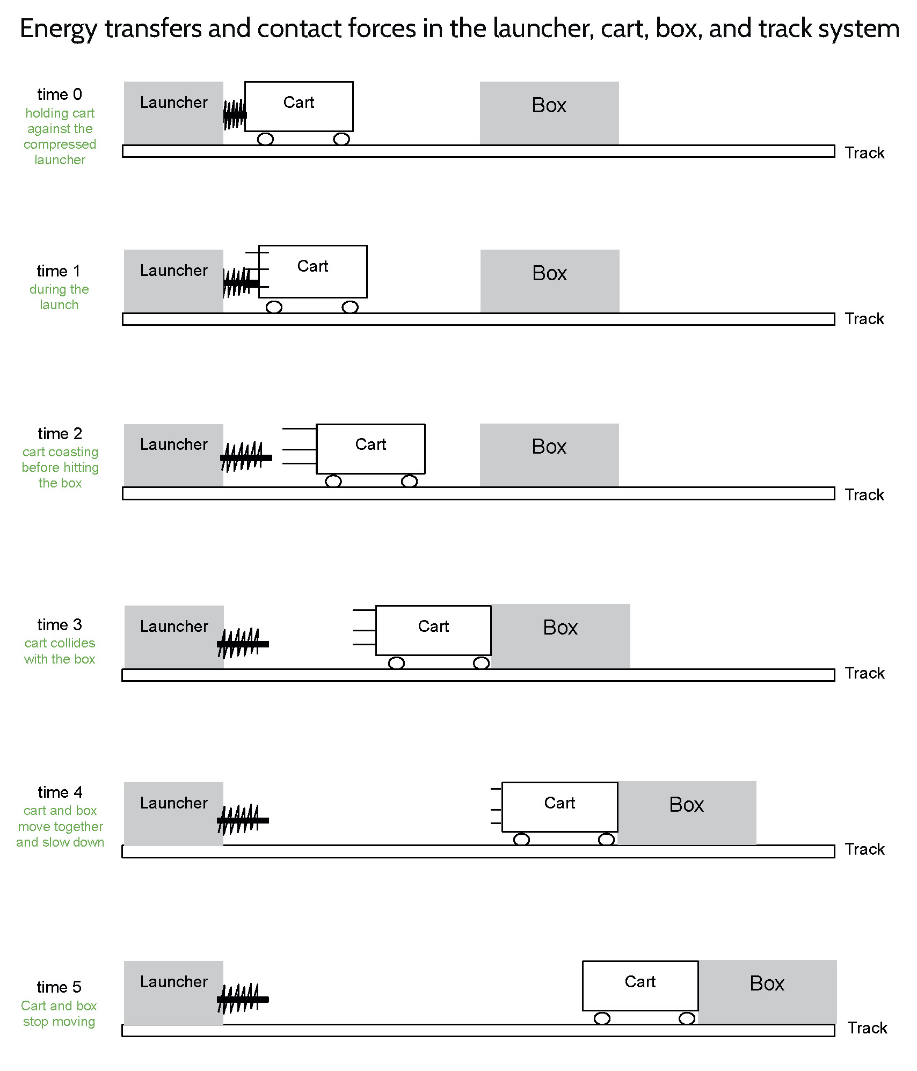
Slide C
Develop a Consensus Model
As a Class
Bring colored pencils and meet in a Scientists Circle to develop a model showing how energy was transferred and where contact forces were occuring in the launcher, cart, box, and track system.
Notes:
Discuss where energy transfer is occuring in the system. Display slide C. Convene students in a Scientists Circle to discuss some of their ideas. Suggested prompts and sample responses can be found in the teacher guide.
Switch to a diagrammatic representation of the system. Say, Let’s capture all of these ideas in a system diagram of the spring launcher, cart, track, and box system. We can use this model to show how energy was transferred through the spring-scale-launched cart system that collided with the box.
Distribute Energy transfers and contact forces in the launcher, cart, track, and box system. Ask students to compare the objects or subsystems represented for each of the times shown in the model and describe what is different and what is the same for each time shown.
Post the premade poster that you created representing the Energy transfer and contact forces in the launcher, cart, box, and track system model. You will use the 16 prelabeled post-its (14 triangular, 2 square, and 2 rectangular) to annotate this model so that you can remove these annotations before the next class and repeat this interaction-system-modeling exercise and discussion with your next class.
Direct students’ attention to time 2 and time 0. Ask students which objects or subsystems have kinetic energy and which do not at time 0 and time 2. Students should say only the cart in time 2 has kinetic energy and nothing else does.
Add the triangular sticky note “has nKE” to the cart at time 2.
Add the triangular sticky note labeled “no KE” to the cart at time 0 and the box at both time 0 and time 2.
Have students add the same annotations to their copy of Energy transfers and contact forces in the launcher, cart, track, and box system.
Introduce the idea that energy can be stored in systems in some cases when the shape or position of parts or objects change. Say, When we compressed the spring scale and held the cart motionless against it, it wasn’t moving, so therefore it has no kinetic energy. But we know energy is transferred from the launcher to the cart when we release it. The compressed spring scale is an example of a subsystem that can store energy that can be transferred out of it later. Compressing the spring by pushing on it allowed us to transfer energy into that part of the subsystem. Holding the spring in place allowed it to remain in a particular shape or position where it could continue to store that energy. And letting go of it allowed the launcher to spring back to its original shape or position. As it returned to its original shape or position, the energy that was stored in that part of the subsystem was transferred back out of it. Scientists also refer to the stored energy in a system that is the result of a change in the position of objects in the system as potential energy.
Review what is causing the energy to get transferred into and out of the system.
Add the triangular sticky note labeled “has stored energy” to the launcher at time 0.
Make a key on a piece of letter sized paper taped to the side of the poster. Add a curved blue arrow to the key and label it “energy is being transferred”.
Add a rectangular sticky note with a curved, blue arrow going from the launcher to the cart at time 1.
Add a red dot to the key and label it “due to contact forces here”. Then ask students where the contact forces are between the launcher and the cart at time 1 that are causing this energy transfer. Students should say where the plunger is touching the back of the cart. Add a small square sticky note with a red dot on it to that location at time 1.
Add the triangular sticky note labeled “stored energy decreases” to the launcher at time 1. Add the triangular sticky note labeled “kinetic energy increases” to the cart at time 1.
Have students add the same annotations to their copy of Energy transfers and contact forces in the launcher, cart, track, and box system.
Point out that the red dot shows where the contact forces are occurring in the system but doesn’t show how many forces there are at that point of contact nor their relative strength like we showed earlier when we made a free body diagram of each object or subsystem in a collision.
For time 1, review how many forces there are at this point of contact and their relative strength.
Prompt students to consider time 3. Ask students what happens to the stationary box when the cart collides with it. Students should say it starts moving.
Ask students where the energy was transferred from that causes the kinetic energy of the box to increase. Students will say from the cart.
Add the triangular sticky note labeled “KE increases” to the box at time 3.
Add a rectangular sticky note with a curved, blue arrow going from the cart to the box at time 3.
Then ask students what must be happening to the kinetic energy of the cart if energy is transferring from it to the box during the collision. Students will say it must be decreasing.
Add the triangular sticky note labeled “KE decreases” on it to the cart at time 3.
Ask students to identify where the contact forces are between the cart and box. Add a small square sticky note with a red dot on it to that location.
Emphasize that, again, we have identified a location in the system where energy transfer is occurring due to contact forces between two objects or subsystems. Have students add the same annotations to their copy of Energy transfers and contact forces in the launcher, cart, track, and box system.
Direct students to time 5, suggesting that you want to identify a few things here first before returning to time 4.
Ask students what we can say about the kinetic energy of all the objects or subsystems at time 5 if everything has stopped moving. Students will say that they have no kinetic energy. Have students add these annotations to the cart and the box in time 5 on their copy of Energy transfers and contact forces in the launcher, cart, track, and box system.
Direct students to time 4, asking what is happening with the speed of the cart and the box as they slide along the track to a stop. Students will say they are slowing down. Have students label both the cart and the box with “KE decreases”.
Problematize something missing from the model. Say, Wait, where did the energy in the system go between time 3 and time 5. Some of the objects had kinetic energy at time 3, but by time 5 there is no kinetic energy in the system. Energy can’t just disappear. It can be transferred from one object, subsystem, or system to another. We saw that happen due to contact forces between certain objects and subsystems at time 1 and time 3. But here at time 4 it's not obvious where that energy went, nor is it obvious what contact forces would have caused this energy transfer. So I don’t think we are done with this model yet. But let’s have you think on your own a bit more about what else might be going on in this system from both an energy transfer perspective and a contact forces perspective.

Slide 4
Slide D
Developing Individual Models
On Your Own
Refer to the annotations we made to the systems model and consider what else might be going on at time 4.
First think about forces in the system at this point in time as you develop and use free body diagrams in your responses to the first 3 questions on your handout.
Then think about energy transfer in the system at this point in time in your responses to the last 2 questions on your handout.
Notes:
Say, We put red circles in our systems model to show where contact forces are occurring. In the past, when we wanted to show more about what the forces are at those red circles, we drew free body diagrams. We haven’t done that for any of our points in time in the model so far. But let’s not forget that free body diagrams are a helpful tool for visualizing the forces acting on objects in the system. Let’s get ready to develop and revise some free body diagrams for both the box and the cart at time 4. Before we do, let’s look back at how we drew the free body diagrams we made in the past.
Review what was included in past free body diagrams the class made in Lesson 5. Cue students to look back at an example of the ones they made in their notebooks and/or on the poster you made as class from Lesson 5. Example prompts and responses can be located in the teacher guide.
Show slide D. Distribute Modeling other force interactions in the launcher, cart, box, and track system. Say, Use the annotations we made to Energy transfers and contact forces in the launcher, cart, track, and box system and consider what else might be going on at time 4, starting first by thinking about forces in the system using free body diagrams. Emphasize that you want to collect this as a formative assessment to see how students are thinking about other forces acting on the box and the cart at this point in time as well as how and where energy transfer may be occuring.
Collect the completed responses before moving to the end of the lesson.

Slide 5

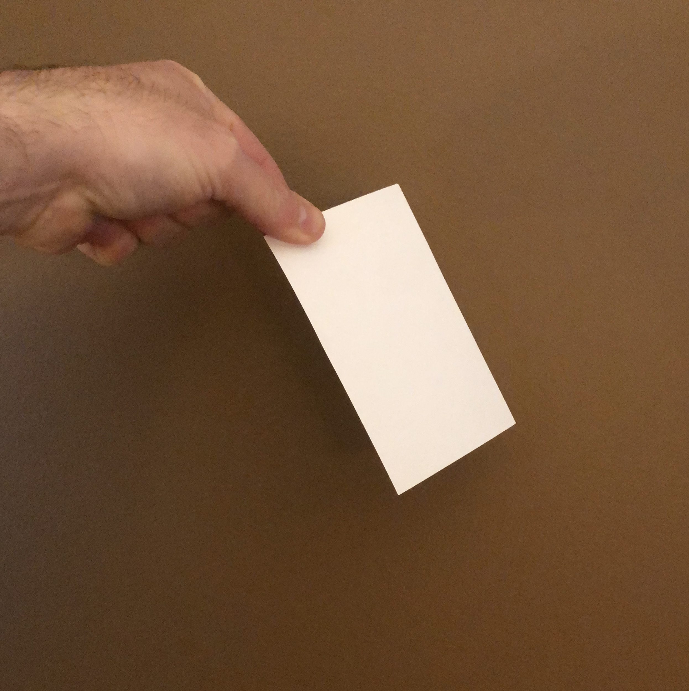
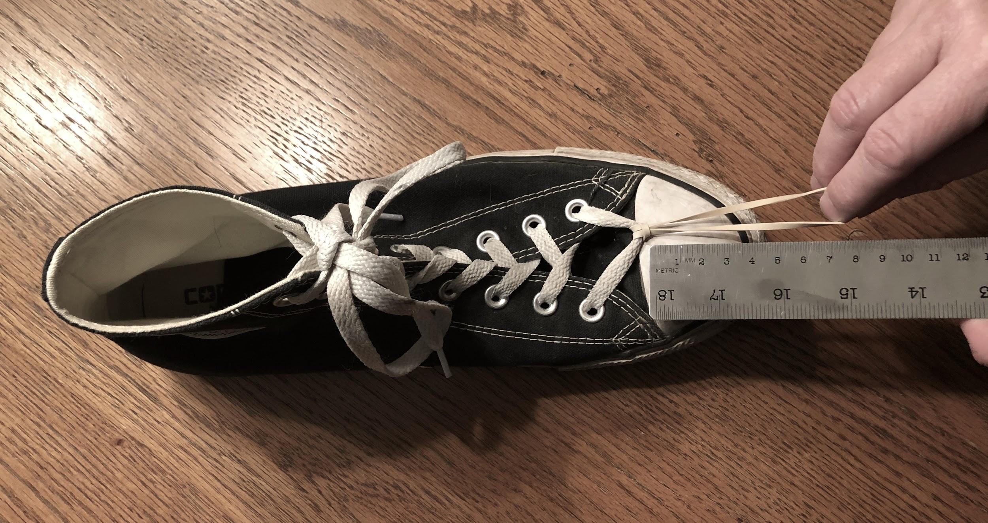
Slide E
Investigations into Air Resistance and Friction
Home Learning
Choose one of these investigations to carry out and report on.
Folding and dropping paper
An air interaction investigation
Take 4 index cards (provided) and complete the related handout.
Pulling a shoe with a rubber band
A surface interaction investigation
Take a rubber band (provided) and complete the related handout.
Notes:
Discuss other sources of contact forces as a whole class. Example prompts and responses can be found in the teacher guide.
Introduce the ideas of friction and air resistance. Students may or may not have used the words friction and air resistance at this point in the unit. If students have used these terms, acknowledge the terms here. If they have not, start to link the words with the concepts. Use one of the two prompts below that best fits your classroom case.
Option 1: Introduce what these two sources of contact forces are commonly called. Say, The contact forces between a moving object and something it is sliding against are commonly called friction, and the contact forces between a moving object and the air particles it collides with are commonly called air resistance.
Option 2: Acknowledge the use of the words friction and air resistance. Say, I hear you all saying the word friction to describe the forces between an object and something it is sliding against. I also hear you using the word air resistance to describe contact forces between a moving object and the air particles that it collides with. These are interesting words. Let’s see if we can really develop our ideas of what these terms mean as we explore these contact forces.
Ask students for a few examples in other systems or phenomena where they think that contact forces due to friction affect the kinetic energy of an object as it moves. Do the same for air resistance. Accept all responses.
Suggest that since these forces may be part of many other systems where there are objects moving, what causes these forces and how they affect the motion of objects before, during, and after a collision appears to be another part of the system model we will need to figure out more about in order to answer our unit driving question, “Why do things sometimes get damaged when they hit each other?”.
Introduce home learning. Show slide E. Say, Tonight you have an option to do one of two investigations. One of these involves folding and dropping index cards to see which shapes you can get to travel more quickly and more slowly through the air. The other involves pulling on a shoe with a rubber band to see how much force it takes to get it to start moving when it is on different surfaces. I will give you supplies that can be used for either investigation, which are four index cards and a rubber band. You pick which investigation you want to do. If you do the latter investigation you will also need a shoe and a ruler.
Distribute four index cards with a rubber band wrapped around them to each student.
Distribute Investigating Surface Interactions to students who select the first investigation to carry out. Distribute Investigating Interactions with the Air to students who select the second investigation to carry out.
Tell students that they will share their results with other students at the start of the next class.
Remove the 16 prelabeled post-its (14 triangular, 2 square, and 2 rectangular) from the poster and set them to the side before the next class so they can be reused for placement on the poster.

